Slide 1

Databases & SQL for Data Science with Python
PROFESSIONAL CERTIFICATE IBM Data Analyst

Slide 2
In this week!
Explain how the entity name and attributes map to a relational database table in ER data model
Identify some commonly used data types
Identify relationships between tables
Describe the function of primary keys & foregin Keys
List some relational databases on the cloud?
Identify SQL Commands Alter, Drop, Truncate

Slide 3
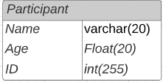
Entity relationship (ER) data model
Suppose we design Npower Canada’s database. In this database, the participants will be an entity with attributes like id, name, age, etc.
Name
ID
Age
Participant
Notes:
An entity relationship model, also called an entity-relationship (ER) diagram, is a graphical representation of entities and their relationships to each other,
ERD that represents entities
called tables and their relationships.
The building blocks of an ER diagram are entities and attributes.

Slide 4
Identify some commonly used data types
Find more here
https://www.w3schools.com/sql/sql_datatypes.asp
Notes:
Ask participants

Slide 5
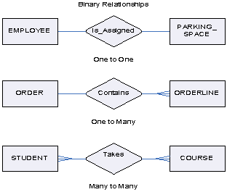
Relationships between tables
one-to-one
Each Employee is assigned to a one parking space, and each parking space is assigned to one employee
one-to-many
Each order contains multiple ordelline, and each ordelline is contained under one order
many-to-many
Each student can have multiple courses, and each course have many students
dragon1.com

Slide 6
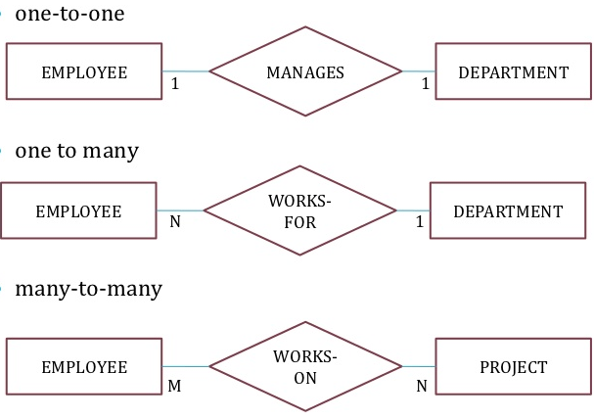
Exercise
Read the relationships!
one-to-one
one-to-many
many-to-many
slideshare.net
Notes:
Notice the difference in the relationship link design (1 – N)

Slide 7
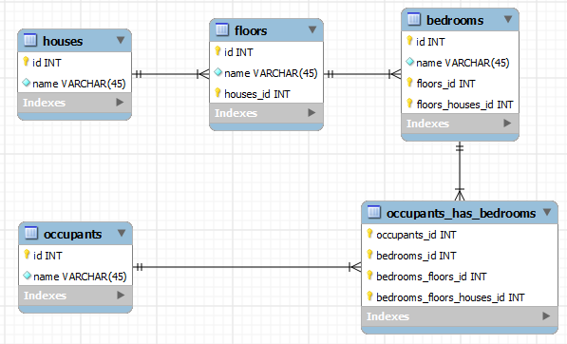
Exercise
Read the relationships!
one-to-one
one-to-many
many-to-many
stackoverflow.com
Notes:
Relationships between tables

Slide 8
Activity: Entity relationship Model
Take 30 minutes, download the “Entity relationship model activity from Schoology.
Review the database scenarios, build the ER models and convert it into tables.
What are the relationships between the tables?

Slide 9
Primary Key
Uniquely identify a record in the table.
In the retail store example what should be the primary key for each table?
Notes:
The primary key of a relational table uniquely identifies each tuple or
row in a table, preventing duplication of data and providing a way of defining
relationships between tables.

Slide 10
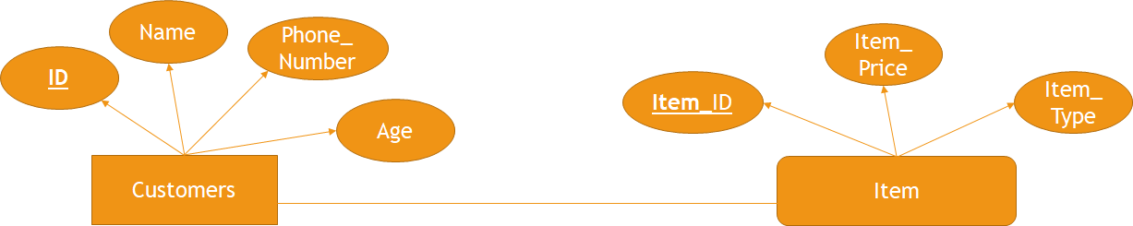
Primary Key
Uniquely identify a record in the table.
In the retail store example what should be the primary key for each table?
1
N

Slide 11
Primary Key
Uniquely identify a record in the table.
In the Npower example what should be the primary key for each table?
Notes:
The primary key of a relational table uniquely identifies each tuple or
row in a table, preventing duplication of data and providing a way of defining
relationships between tables.

Slide 12
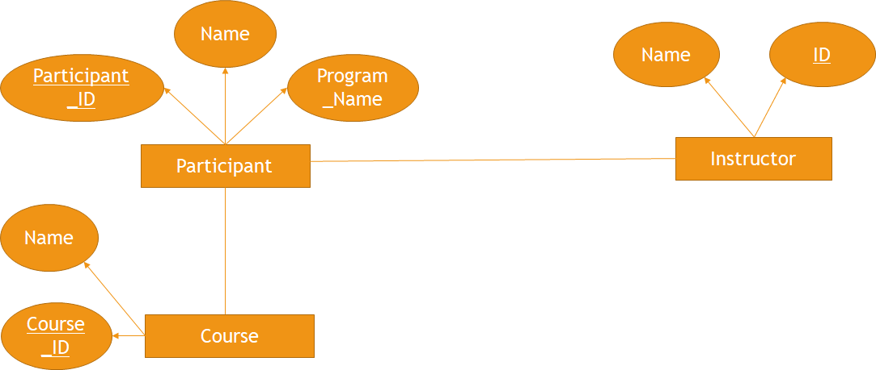
Primary Key
N
1
N
M
Notes:
The primary key of a relational table uniquely identifies each tuple or
row in a table, preventing duplication of data and providing a way of defining
relationships between tables.

Slide 13
Foreign keys
Tables can also contain foreign keys which are primary keys defined in other tables, creating a link between the tables.
Notes:
Ask participants for examples?

Slide 14
Databases on the cloud
What are the advantages of using DB on cloud?

Slide 15
Databases on the cloud
What are the advantages of using DB on cloud?
Ease of use and access
Scalability & Economics
Disaster recovery

Slide 16
Relational databases on Cloud
List some relational databases on the cloud?

Slide 17
Relational databases on Cloud
IBM Db2 on Cloud
Databases for PostgreSQL on IBM Cloud
Oracle Database Cloud Service
Microsoft Azure SQL Database
Amazon Relational Database Services

Slide 18




Alter
ALTER TABLE table_name ADD column_name datatype;
ALTER TABLE table_name ALTER COLUMN column_name datatype;
Add or remove columns from a table,
Modify the data type of columns
Add or remove keys
Add or remove constraints

Slide 19
Drop
ALTER TABLE table_name DROP COLUMN column_name;
DROP TABLE table_name;

Slide 20
Exercise
Write SQL statement that adds an "Email" column to the "Customers" table

Slide 21
Exercise
Write SQL statement that adds an "Email" column to the "Customers" table
ALTER TABLE Customers ADD Email varchar(255);

Slide 22
Exercise
What is the result of the following statement DROP TABLE Book;
Delete the entire Book table
Delete the data inside the Book table
Delete the Book column in the Library table
Notes:
A

Slide 23
Truncate
Delete the data in a table rather than deleting the table itself
TRUNCATE TABLE table_name IMMEDIATE;
Notes:
The DELETE statement without a WHERE clause allows you to delete all rows from a table.
However, if you have a table with a large volume of data, the DELETE statement will not be efficient.
Fortunately, Db2 provides the TRUNCATE TABLE that also delete all rows from a table, but in a more efficient way.

Slide 24
Exercise
What is the result of the following statement Truncate TABLE Book IMMEDIATE;
Delete the entire Book table
Delete the data inside the Book table
Delete the Book column in the Library table
Notes:
B

Slide 25
Hands-on Labs
Take 60 min to complete the hands-on Labs On Coursera:
CREATE, ALTER, TRUNCATE, DROP
Create and Load Tables using SQL Scripts

Slide 26
Summary: Group Discussion Activity
Download week 2 summary review questions from Schoology.
Discuss your answers in the main group

Slide 27
Any questions

